Slide 1
FUNDAMENTALS OF TABLEAU
James Larkin – Data Analytics Instructor

Slide 2
UNIT 3: VISUALIZATION
1: Fundamentals of Tableau
2: Visual & Text Manipulation
3: Social Media Analysis*
4: Calculations & Analysis
5: Dashboards & Storypoints
6: Statistical Analysis*
7: Python & Beyond
Notes:
NOTE: Lessons with a * next to them represent FLEX materials

Slide 3
FUNDAMENTALS OF TABLEAU
LEARNING OBJECTIVES
After this lesson, you will be able to:
Connect and prepare data to import into Tableau.
Navigate the Tableau interface.
Build graphs, calculations, dashboards, and stories.
Learn to discriminate between discrete and continuous dates in Tableau.
Apply your new skills to sample data.

Slide 4
BEFORE WE BEGIN
Please download the following files for today’s lesson:
Data files:
Divvy Trips data set (a zip file).
Move the zip file to this destination, then click “Extract All:” Documents > My Tableau Repository > Datasources > 10.# > en_US-US.
Tableau activity workbooks:
Fundamentals activities.
Fundamentals activities (stretch).
Move these Tableau Workbook files to this destination: Documents > My Tableau Repository > Workbooks.

Slide 5
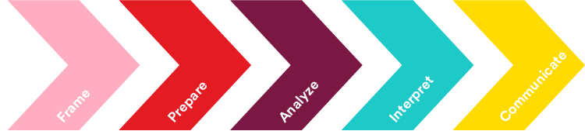
RECAP: DATA WORKFLOW
In Units 1 and 2, we showed you how to use Excel and SQL to frame, prepare, and analyze your data.
In Unit 3, we’ll show you how to use Tableau to interpret results and communicate your findings to a variety of stakeholders and audiences.
Develop a hypothesis- driven approach to analysis.
Select, import, explore, and clean data.
Structure, visualize, and complete analysis.
Make business decisions from data.
Present data-driven insights to an audience.

Slide 6




OPENING
So far, we’ve learned how to use SQL to quickly query and retrieve data sets of different sizes.
We’ve also learned how to organize and visualize our data with Excel. Excel can create many graphs and charts, but Tableau offers other powerful tools for analyzing and visualizing our data.
In this unit, we’ll learn how to leverage Tableau to create custom dashboards and share data narratives with our audiences.
Excel Wizard
SQL Ninja

Slide 7

FUNDAMENTALS OF TABLEAU
INTRODUCTION

Slide 8
INTRODUCTION TO TABLEAU
What is Tableau?
Tableau is a visual analytics and data discovery tool launched as the result of a Stanford research collaboration between data and visualization labs. It’s based on a patent called “Polaris” that covers interactive visual data querying.
There are a number of players in the drag-and-drop/visual data space. Power BI from Microsoft will hook into your Azure data set, and Amazon QuickSight will hook into your Redshift data. There’s also Looker, Periscope Data, Qlik, and many other competitors.
Making a decision about which to use will be a trade off between cost, ease of use, features offered, and data connections. Be sure to choose wisely.

Slide 9
INTRODUCTION TO TABLEAU
What is Tableau?
Tableau seamlessly creates background SQL queries called “VizQL” as you interactively click, drag, and drop data elements to explore and interrogate your data.
While Tableau is designed to be used by a range of business users and non-technical audiences, it also provides access to a deep computational ability for advanced data analytics.
Notes:
Instructor Note: So far, students have been required to develop their own SQL queries. Tableau does this in the background whenever data elements are dragged into the visualization pane.
For those interested, you can turn on a log file generator option in Tableau to view the actual VizQL statements generated behind the scenes.

Slide 10
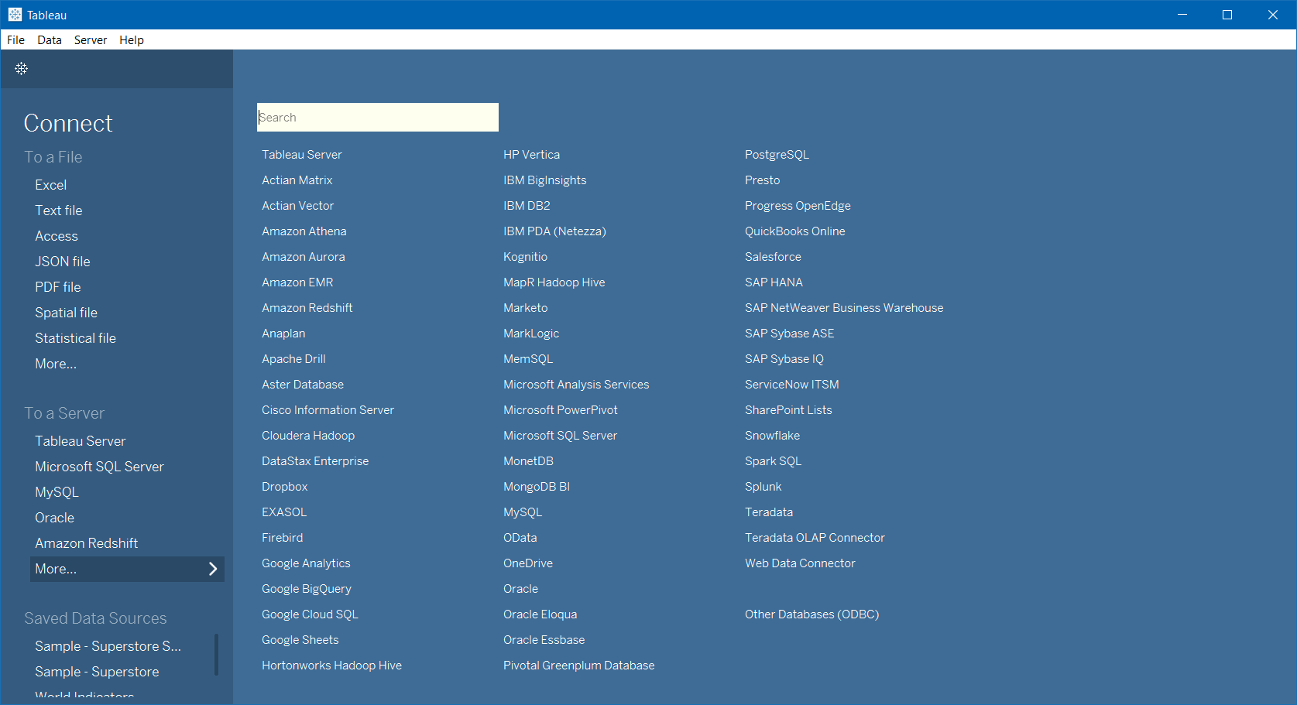
DATA DEMOCRACY: TABLEAU’S 60+ BUILT-IN CONNECTORS
Notes:
Tableau’s built-in data connectors support more than 60 data types. Data types not directly supported by Tableau may be connected using the web data connector or the open database connector (ODBC).

Slide 11

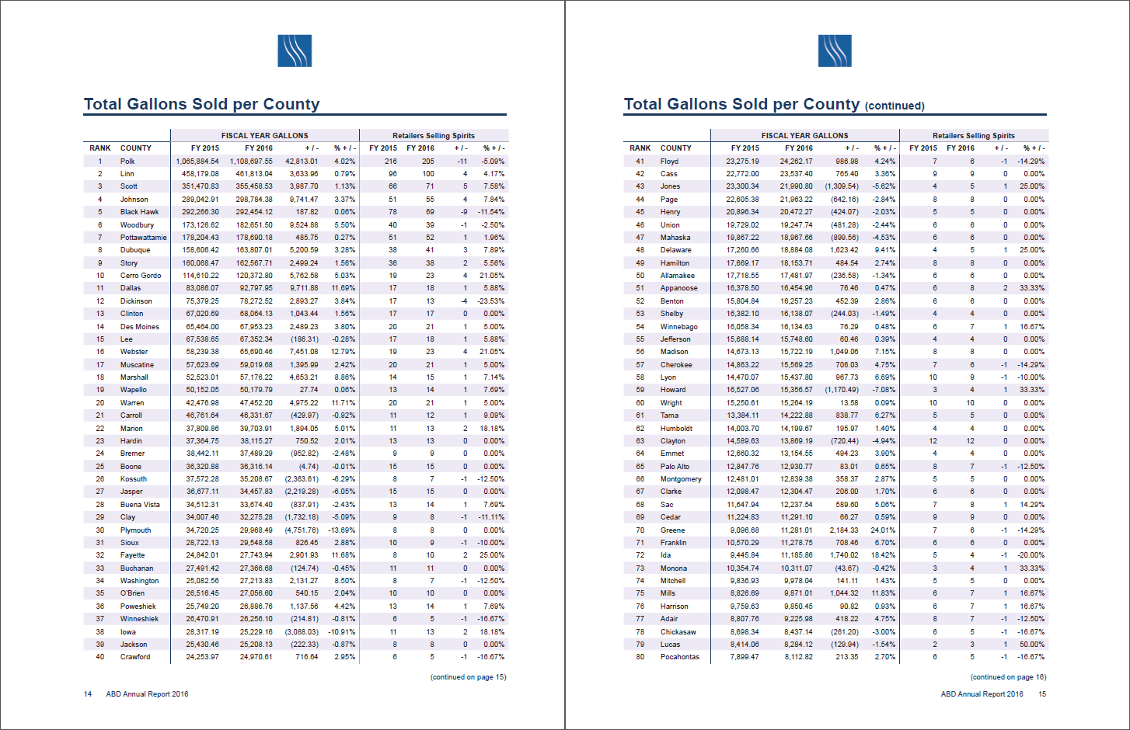
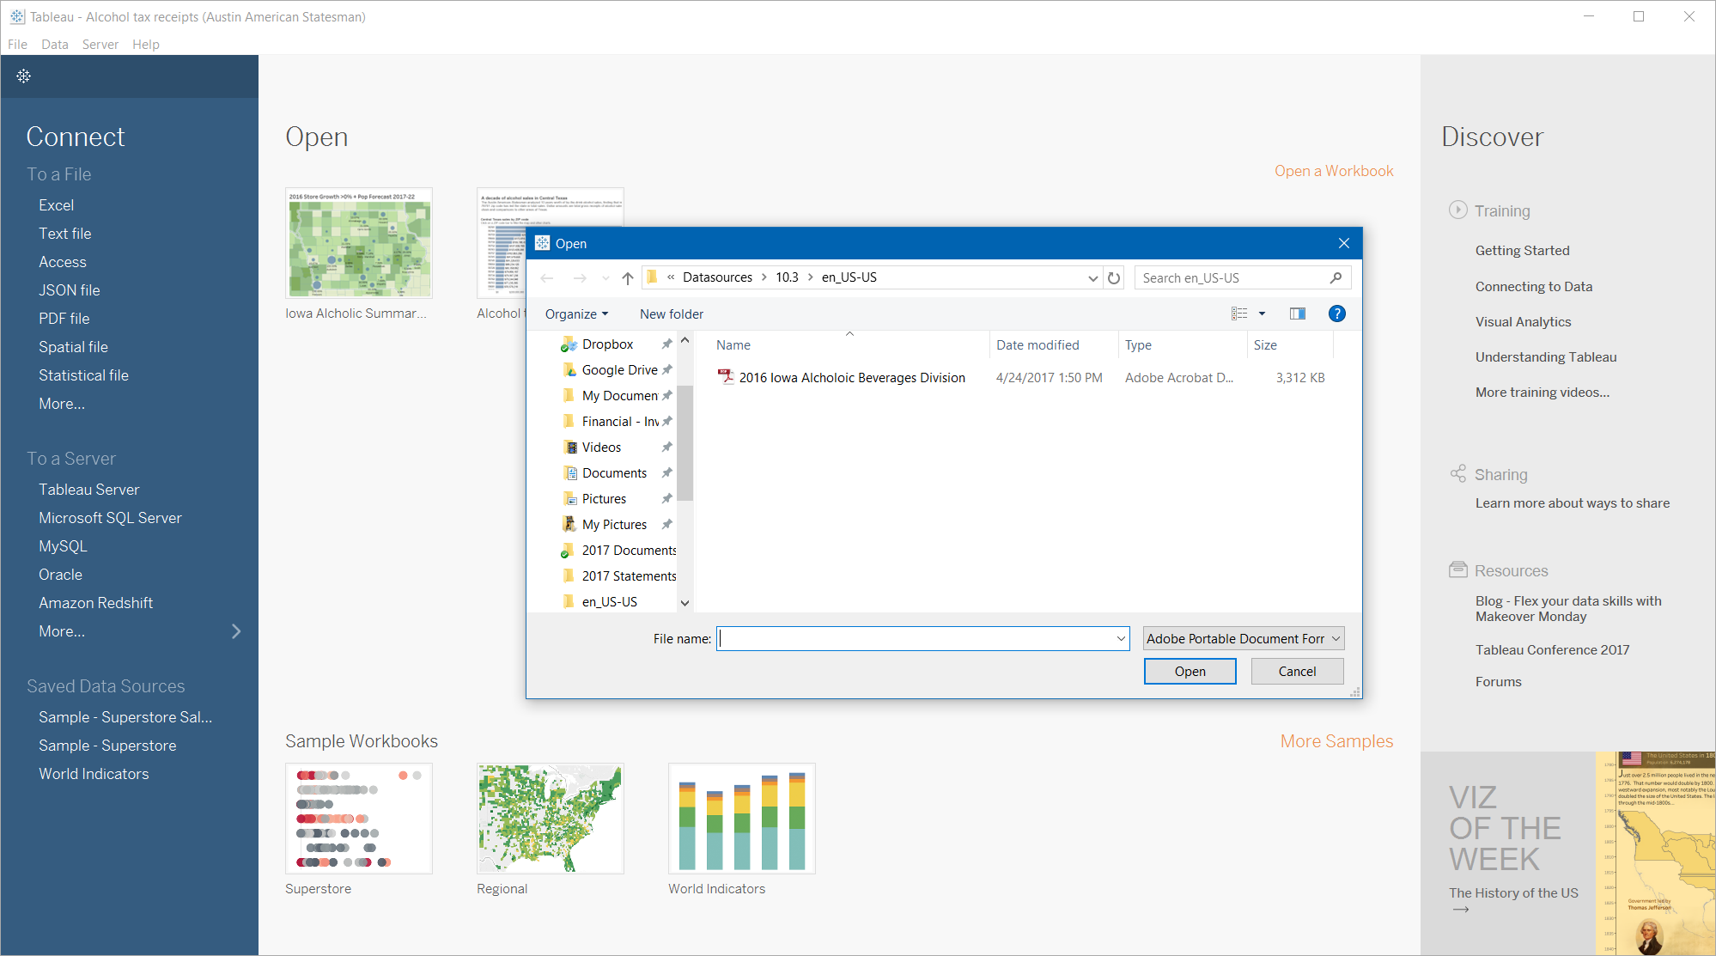
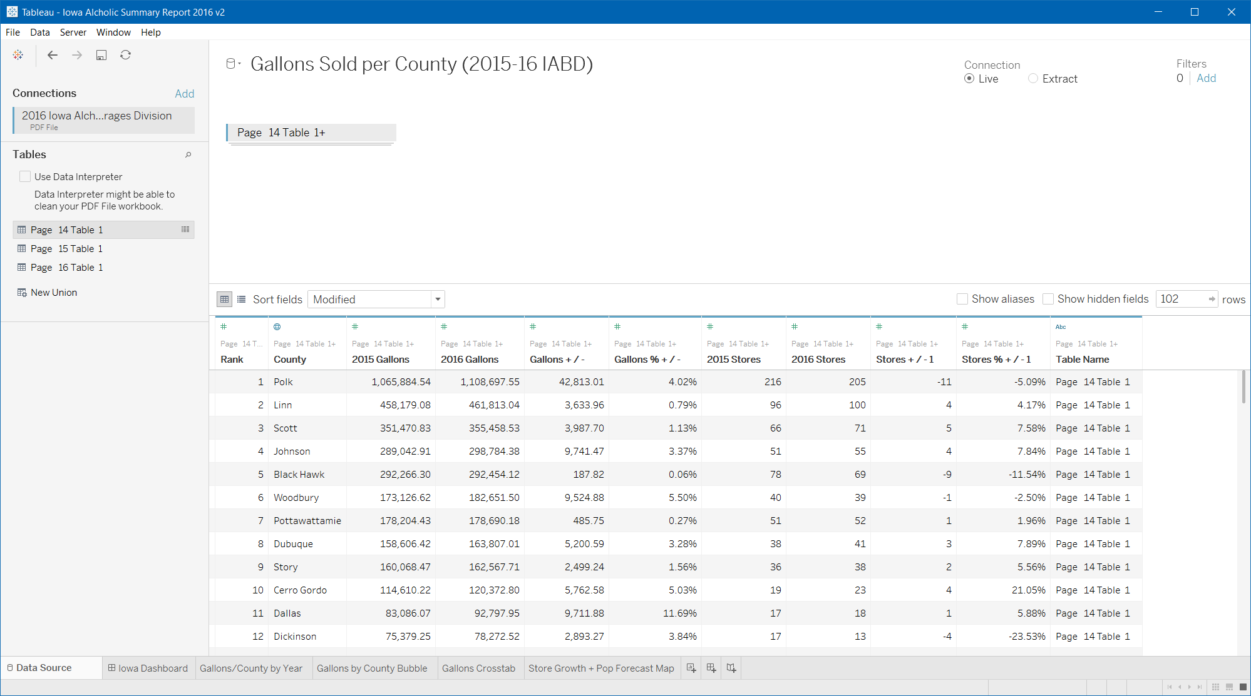
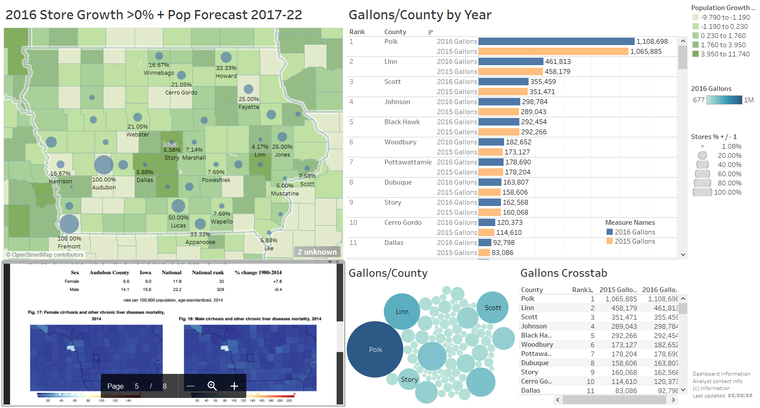
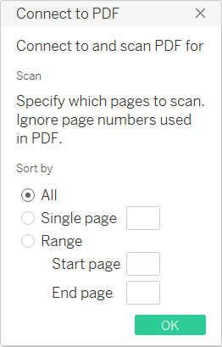
DATA DEMOCRACY: TABLEAU’S PDF CONNECTOR
Tableau can now import data from original PDF report tables!
Remember this dataset from our SQL exercises?
Notes:
This slide serves as a transition and scaffolding from the prior SQL lessons to Tableau. Tableau’s new PDF data connector can “scrape” data tables from PDF format documents and bring them directly into Tableau’s data pane. In the example above, there are three pages of data in the document. They can be UNIONed by drag and drop and then used to create visualizations and dashboards.

Slide 12
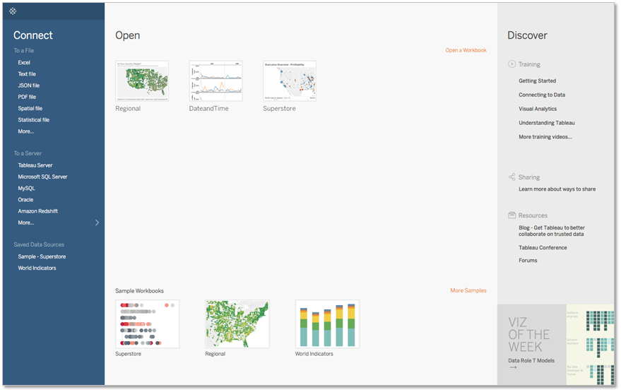
INTRODUCTION TO TABLEAU: INTERFACE OVERVIEW
Click on the video to start.
Runtime 4:57
Source: https://goo.gl/x1npZa
Notes:
OPTIONAL: The following video shows a quick overview of the Tableau interface. This can be assigned as required reading or viewed individually.
Video link: https://goo.gl/x1npZa
Video runtime: 4:57

Slide 13
FUNDAMENTALS OF TABLEAU
TRANSITIONING
FROM SQL TO
TABLEAU

Slide 14
TRANSITIONING FROM SQL
Tableau is a visual way to generate SQL statements (“VizQL”).
While viewing the next few slides, let’s consider and discuss these statements:
How do parts of the Tableau interface relate to SQL commands?
How are SQL and Tableau similar and different?

Slide 15
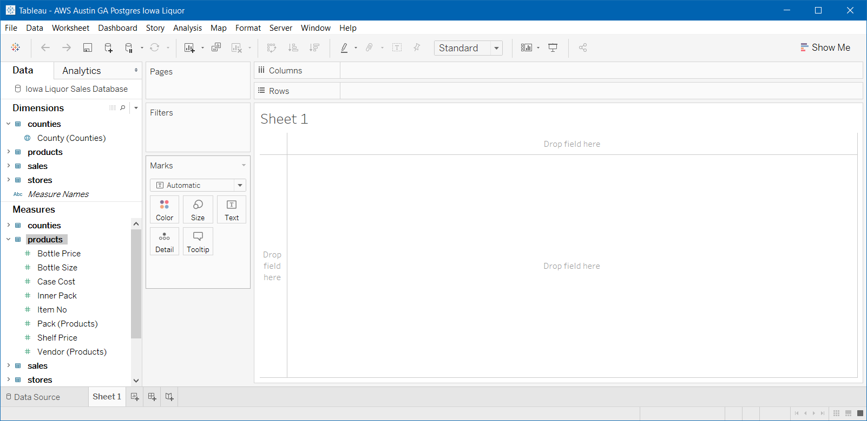
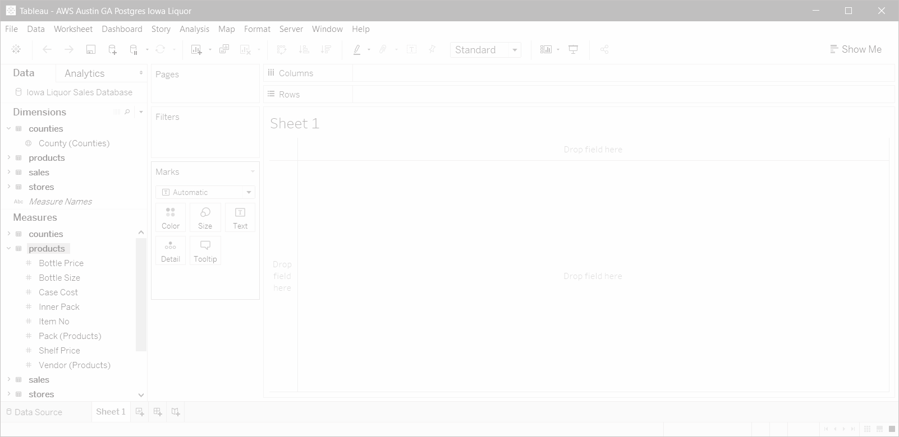
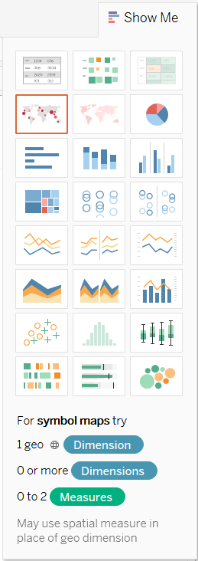
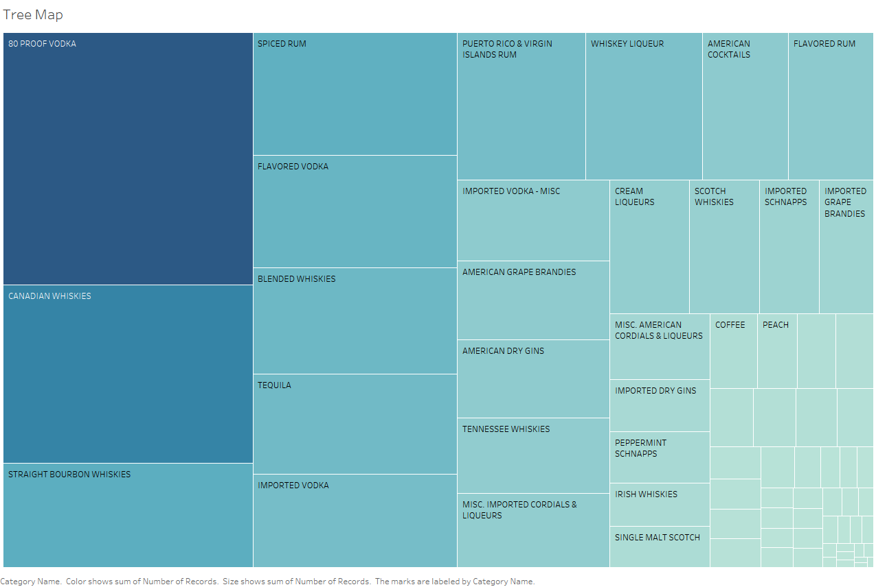
TABLEAU BASICS: VizQL → SQL ANALOGS
Tableau internally generates VizQL based on where data are placed on the view.
FROM
SELECT
WHERE
SELECT
Notes:
Here is a Tableau visualization (a tree map) using a direct connect via AWS to the Iowa Database (possibly using the same credentials as past pgAdmin exercises).
Notice the analogs in the Tableau interface to where data elements (dimensions and measures) may be dropped to SELECT data FROM a source WHERE conditions are met.
This may help students build upon their previous understanding of SQL logic as they begin to learn and understand Tableau’s interface and navigation.

Slide 16
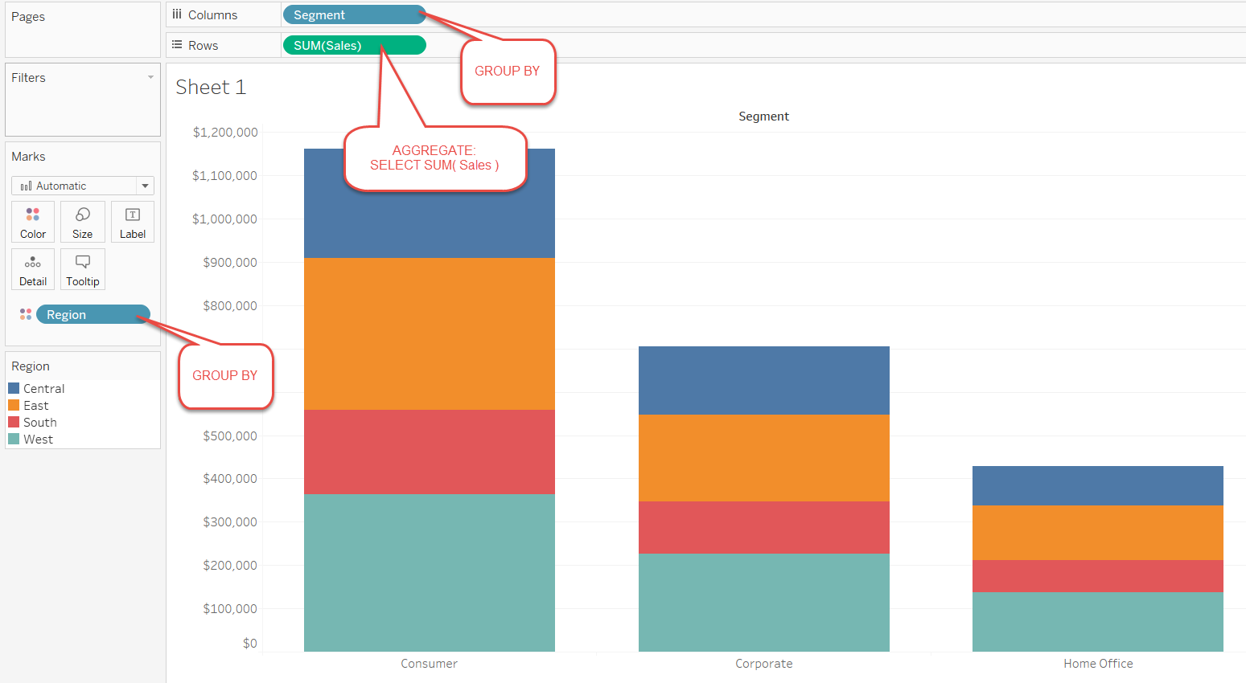
TABLEAU’s VizQL to SQL ANALOGS
Dimensions are fields that contain discrete qualitative data. Examples of dimensions include dates, customer names, and customer segments. They are shown as blue.
Dimensions allow you to “slice and dice” your data. They are added into GROUP BY statements.
Notes:
Dimensions are fields that contain discrete qualitative data. Examples of dimensions include dates, customer names, and customer segments. They are shown as blue.

Slide 17
TABLEAU’s VizQL to SQL ANALOGS
Measures (shown as green) are fields that contain continuous numerical data that can be aggregated. Examples of measures include sales, profit, number of employees, temperature, frequency, pressure, etc.
Measures are metrics and can be aggregated via SELECT.
Notes:
Measures (shown as green) are fields that contain numerical data that can be aggregated. Examples of measures include sales, profit, number of employees, temperature, frequency, pressure, etc.

Slide 18
VISUALIZATION TYPES
The four primary elements of a Tableau visualization (or “Viz”) are:
Columns: x axis.
Rows: y axis.
Mark card: color, size, and text.
Mark type: line, bar, square, circle, shape, area, etc.
Notes:
Basic Tableau navigation and visualization terms. On the following example slides, ask students to identify these elements.

Slide 19
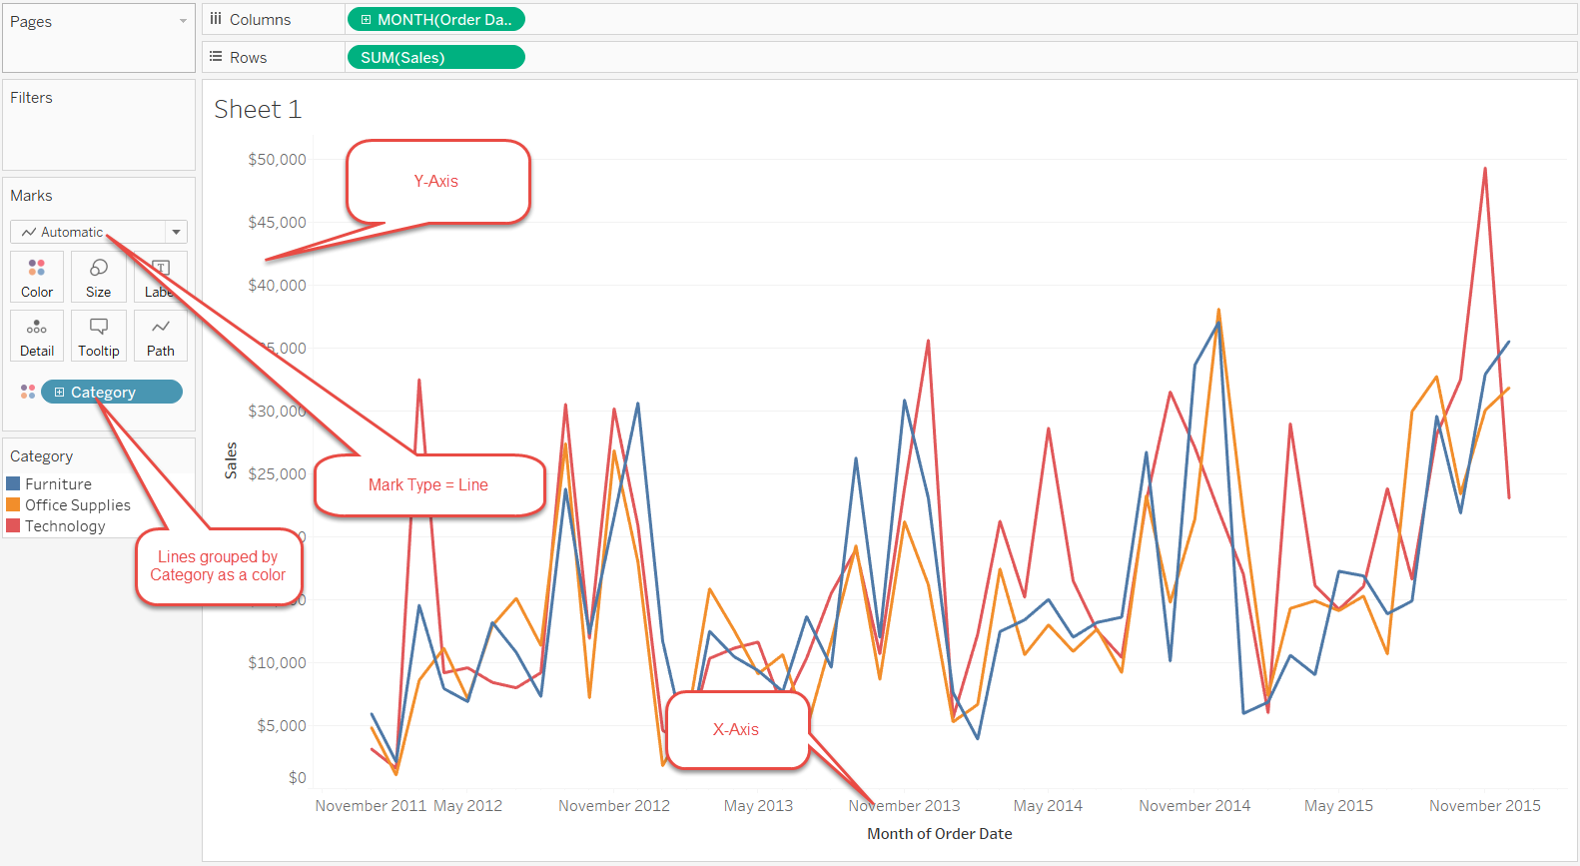
TABLEAU VISUALIZATION PANE
Notes:
Instructor Note: Illustration of these terms and their interface locations:
Columns: x axis.
Rows: y axis.
Mark card: color, size, and text.
Mark type: line, bar, square, circle, shape, area, etc.

Slide 20

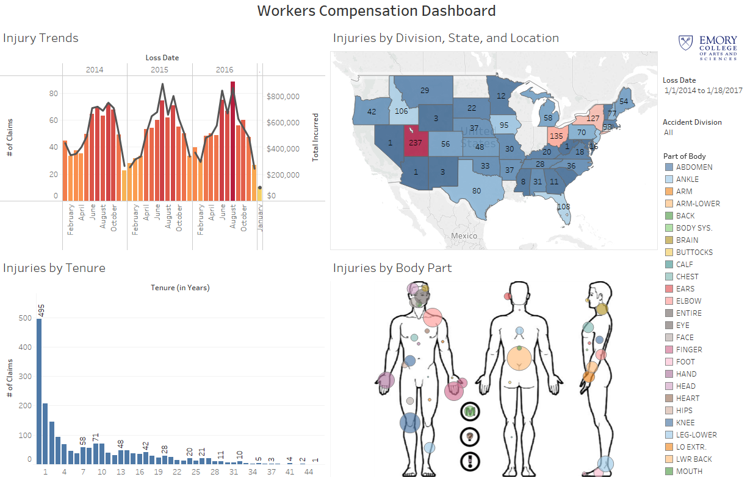
TABLEAU EXAMPLES
Notes:
Examples from Tableau Public, the public domain gallery website: https://public.tableau.com/en-us/s/gallery.

Slide 21
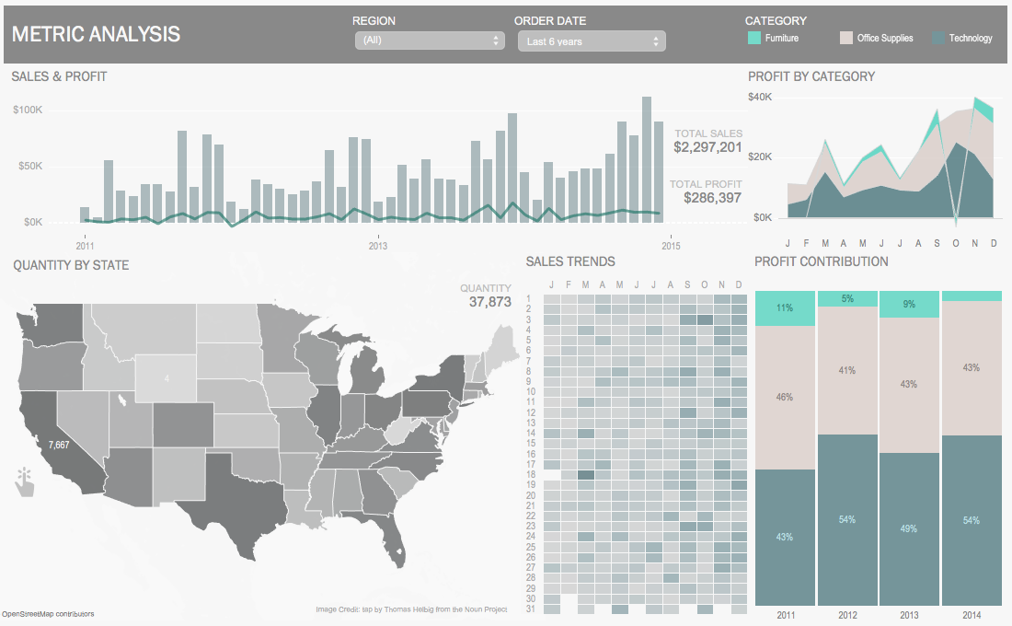
TABLEAU EXAMPLES
Notes:
Another Tableau Public visualization gallery example. This one was created using the built-in “Superstore” demo database.
Note the clean layout and use of color theory (from day one’s lesson).

Slide 22
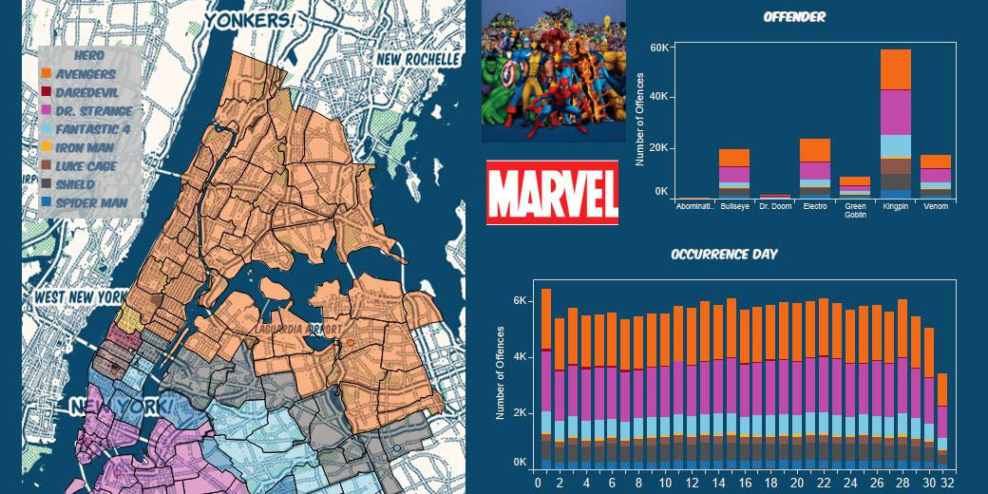
TABLEAU EXAMPLES
Notes:
Another Tableau Public visualization gallery example, which illustrates the wide variety of interests that may use data to illustrate and tell a story.

Slide 23
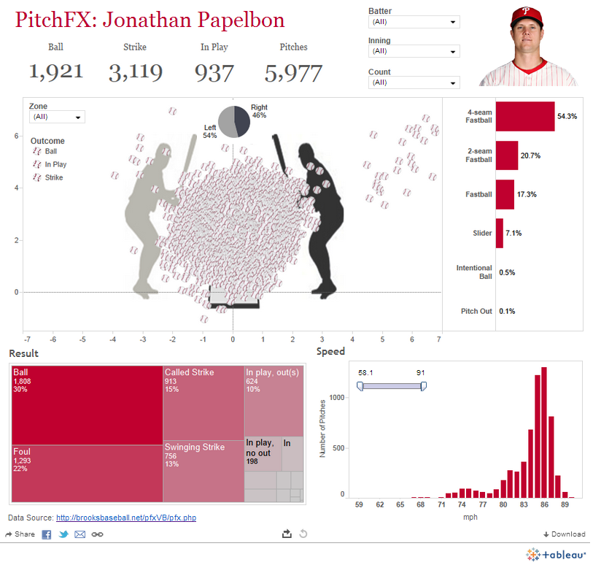
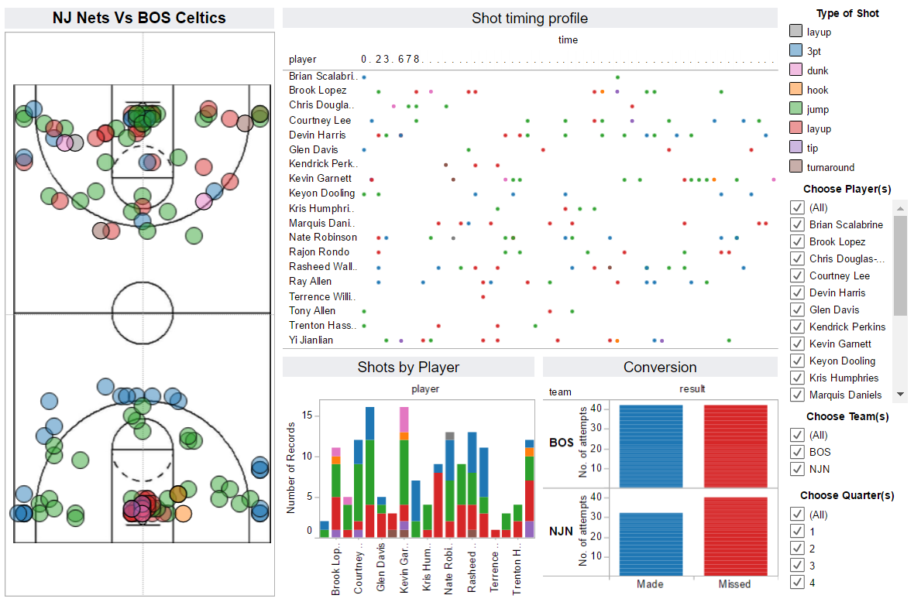
TABLEAU EXAMPLES
Notes:
Another Tableau Public visualization gallery example. Tableau has been used by newspapers, blogs, analysts, and sporting agencies to visualize player and team stats.

Slide 24
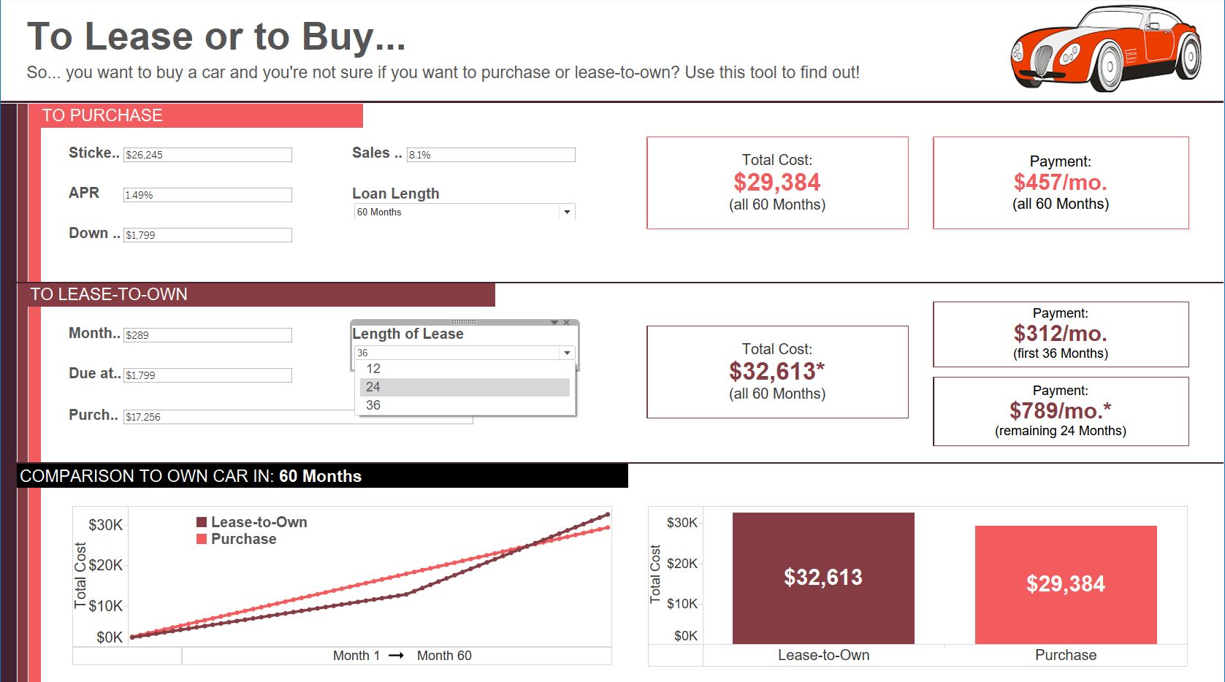
TABLEAU EXAMPLES
Notes:
Another Tableau Public visualization gallery example. This is an example of an interactive dashboard that prompts for user input (of parameters) to inform a resulting analysis and visual output.

Slide 25

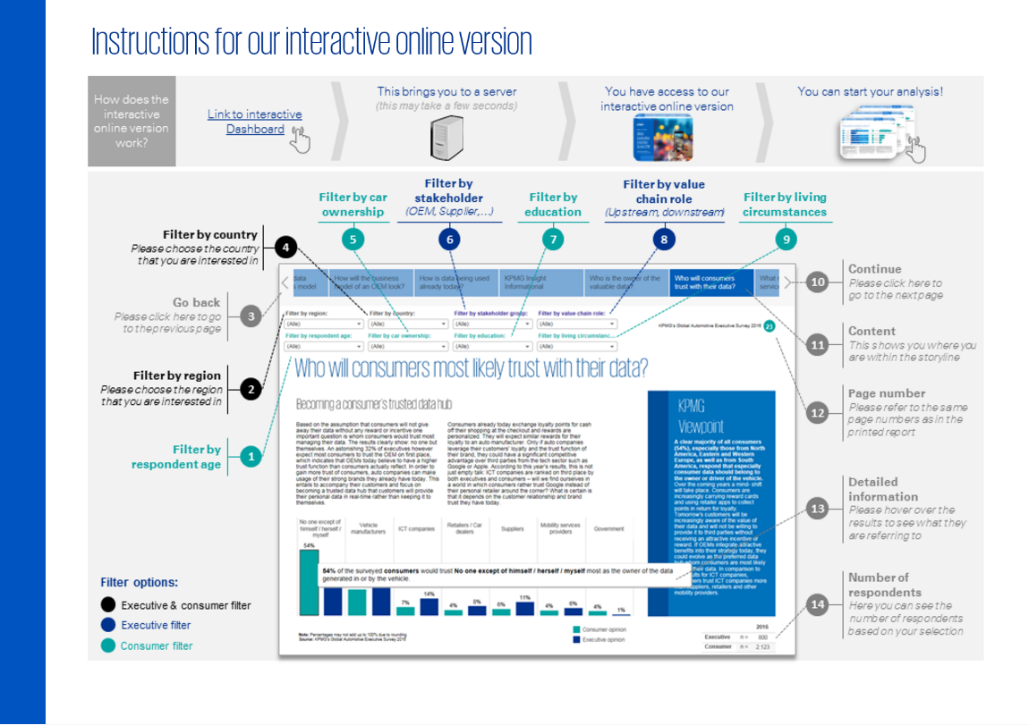
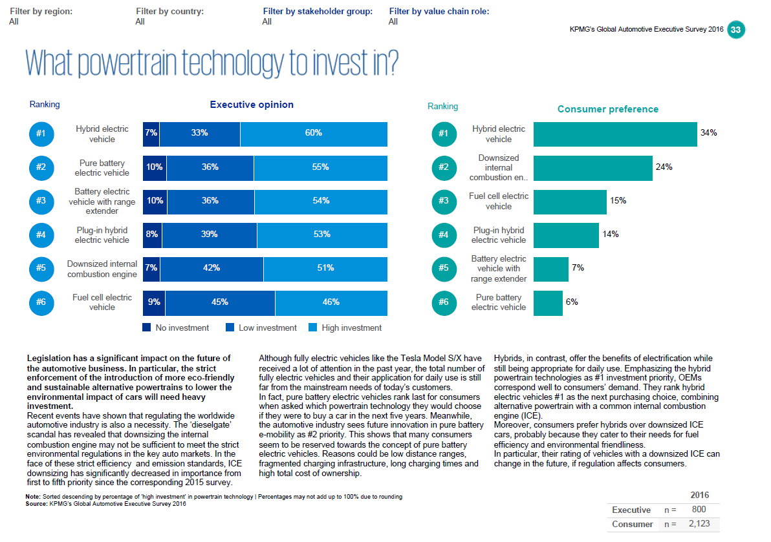
TABLEAU EXAMPLES
Notes:
Another Tableau Public visualization gallery example from a well-known accounting/consulting firm. It used Tableau to create an interactive executive report (using Tableau’s unique “Story Points” feature).

Slide 26



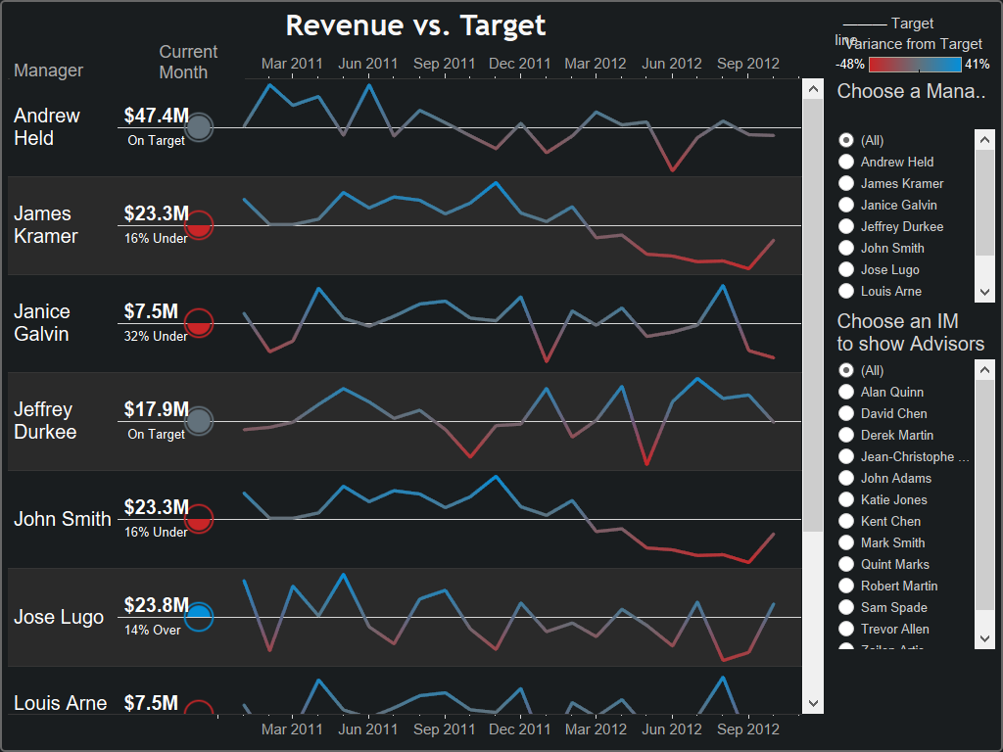
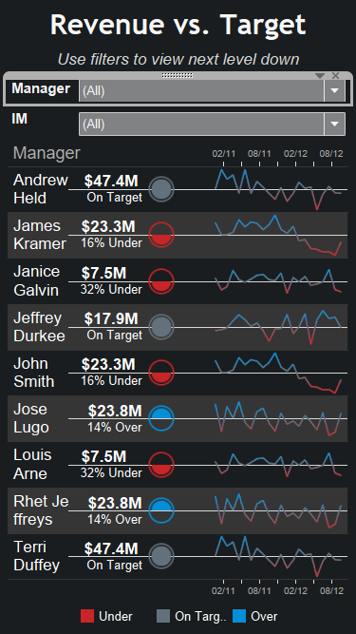
TABLEAU EXAMPLES
Notes:
Another Tableau example from a leading visualization developer and service provider (Interworks).

Slide 27
FUNDAMENTALS OF TABLEAU
GUIDED PRACTICE: CONNECT TO DATA

Slide 28
CONNECT TO DATA AND NAVIGATE
For this lesson, we will be using the Divvy bike share data.
We’ll work through the data together, asking questions as we go.
For context, in this data set:
Every row of data is a trip.
Every trip has a start and stop time.
Every trip has a “from” location and “to” location.
Notes:
Divvy Bikes is a Chicago-based bike rental company (www.divvybikes.com). The data set for this exercise is from the real world and was downloaded with permission from the Divvy Bikes site for use in analysis and reporting.

Slide 29
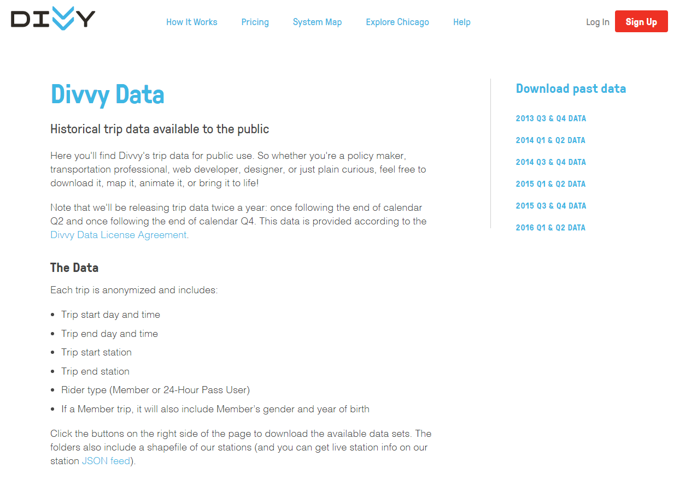


Notes:
Screenshot of the Divvy Bikes data web page with a brief data description: https://www.divvybikes.com/system-data.

Slide 30


Metadata for Trips Tables:
Variables:
trip_id: ID attached to each trip taken
starttime: day and time trip started, in CST
stoptime: day and time trip ended, in CST
bikeid: ID attached to each bike
tripduration: time of trip in seconds
from_station_name: name of station where trip originated
to_station_name: name of station where trip terminated
from_station_id: ID of station where trip originated
to_station_id: ID of station where trip terminated
usertype: "Customer" is a rider who purchased a 24-Hour Pass; "Subscriber" is a rider who purchased an Annual Membership; "Dependent" is a family member related to a Subscriber;
gender: gender of rider
birthyear: birth year of rider
Notes:
First row contains column names
Trips that did not include a start or end date were removed from original table
Gender and birthday are only available for Subscribers (or their Dependents)
Metadata for Divvy Stations Table:
Variables:
id: ID attached to each station
name: station name
latitude: station latitude
longitude: station longitude
dpcapacity: number of total docks at each station
online_date: date the station went live in the system
Notes:
Data dictionary for the Divvy Bikes data sets used in the upcoming Tableau exercises. We suggest students reference this when they subsequently share “the story of one row” of these data sets.

Slide 31
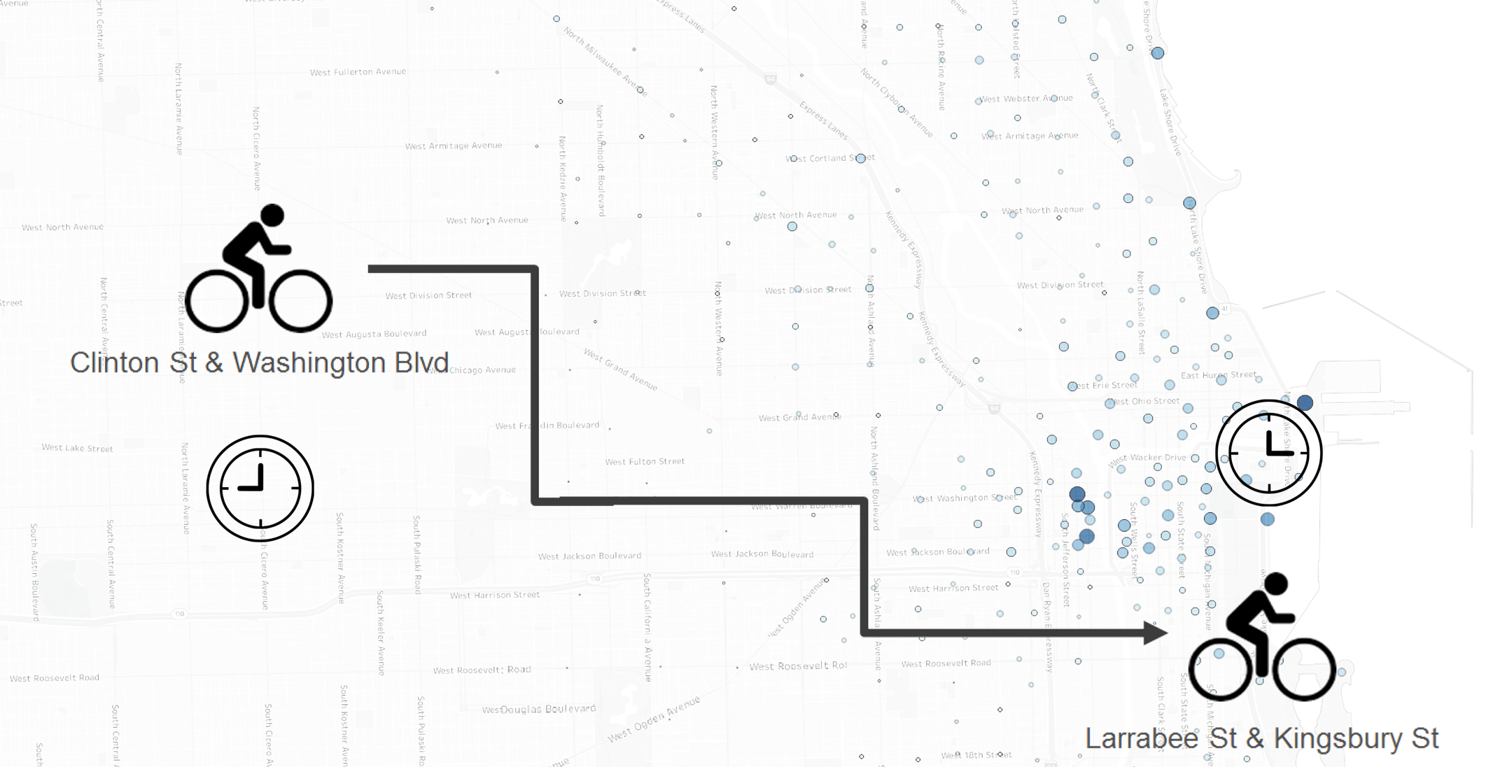
CONNECT TO DATA AND NAVIGATE
Notes:
Simple illustration of what is included in these data sets: Start time, starting station, stop time, and destination station.

Slide 32
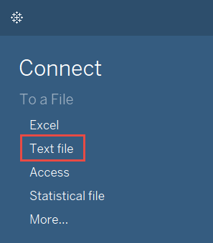

CONNECT TO DATA AND NAVIGATE
Let’s get started by connecting to the data set.
Notes:
Tableau menu interface used to access the text data (.csv) files.

Slide 33
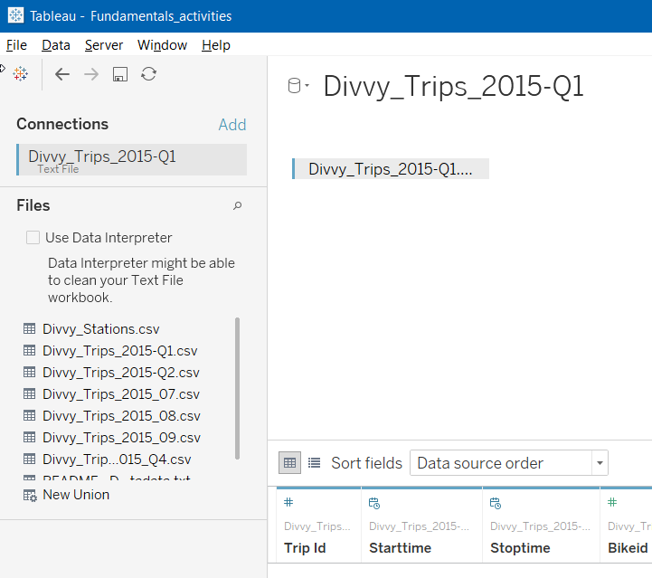
CONNECT TO DIVVY BIKE DATA
Navigate to the “Datasource” folder, where you should have already copied the Divvy Trips data files (if not, please do so now).
Locate and double click the .csv file: Divvy_Trips_2015-Q1.
Tableau will load the file into the data pane, and the related data files will show up to the left.
We will perform a drag-and-drop UNION, as Divvy Trips’ tables are separate files.
Notes:
Tableau menu interface used to access the text data (.csv) files.

Slide 34
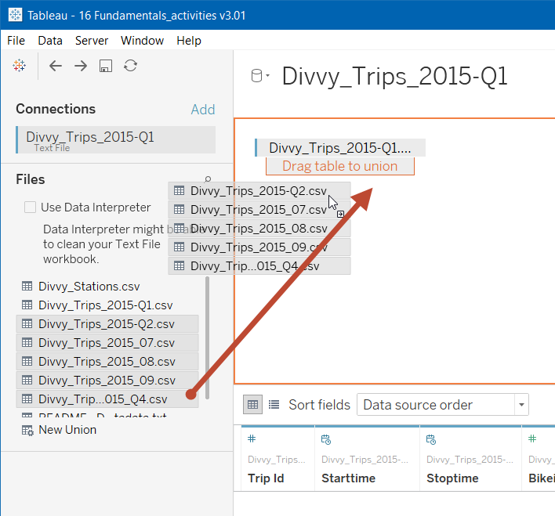

CONNECT TO DIVVY BIKE DATA: UNION THE DATA FILES
Recall from the SQL section that files may be combined by a UNION. The Divvy Trips source data comes in months and quarters, which we want to combine into one data table.
To do so, simply shift-select the remaining five Divvy_Trips data files, then drag and release them on the bottom edge of Divvy_Trips_2015-Q1.
The data pane will now reflect Divvy_Trips as a UNION.
Notes:
Instructor Note: Right click and select edit UNION to show and confirm the files that are in this UNION.
Note how much easier this drag-and-drop operation is with Tableau than pgAdmin, etc.

Slide 35

CONNECT TO DIVVY BIKE DATA: CREATE A TABLEAU EXTRACT
Data may be accessed in Tableau either live or as an extract.
Live connections are best for relatively small or very fast data sources.
Data extracts bring the live data into a Tableau columnar database, which is highly optimized for speed and visual data interaction.
Click on the Extract button under “Connection.”
Now select then the “#records” worksheet tab.
Tableau will take up to one minute to build the extract.
Saving Tableau as a “Packaged Workbook” will include data from the extract.
Notes:
Instructor Note: Describe the benefits of Tableau data extracts.
Point out that an extract will need to be refreshed if the underlying data changes. Refreshes can be automated on Tableau’s server.

Slide 36
FUNDAMENTALS OF TABLEAU
GUIDED PRACTICE: BUILDING DIVVY BIKES
VISUALIZATIONS

Slide 37
CONNECT TO DATA AND NAVIGATE
Let’s build a few visualizations to explore the Divvy Bike tables.
Here are some questions we’ll use visualizations to answer:
The number of Divvy users by type and originating station [stacked bar].
The bikes used for less than 100 trips (by Bikeid) [stacked bar chart].
The age of Divvy Bike users (year of birth) [using a histogram].
The average trip times for each Divvy Bike location.
Pro Tip: This will require us to JOIN to the Divvy Stations table.

Slide 38
FUNDAMENTALS OF TABLEAU
INDEPENDENT PRACTICE: BUILD GRAPHS TO ANSWER QUESTIONS

Slide 39

ACTIVITY: DASHBOARDS AND STORIES
Take the next 10 minutes to build out visualizations to answer the following questions.
Use from_station_name for this exercise.
How many stations are there in the data set?
Which station had the most trips?
Which station had the longest recorded trip duration?
After that’s completed, discuss which graphs are most effective for answering each question.
EXERCISE
Notes:
Note: This activity is referencing the Divvy bike share data sets: Divvy_Trips and Divvy_Stations. These are contained in a compressed file, “Divvy_Trips_dataset (for Lesson 15)”.zip.
This activity will require use of the dimension “from_station_name” to create a Viz to answer the question.
For sample solutions, see the “Fundamentals_solutions v3.01.twbx” file.

Slide 40
FUNDAMENTALS OF TABLEAU
GUIDED PRACTICE: WORKING WITH DATES

Slide 41
WORKING WITH DATES
Dates can be used in a variety of ways in Tableau. The most important concept to understand is continuous versus discrete uses for dates in Tableau.
Discrete dates create bins, while continuous dates create axes.
If you visualize each month as a discrete date, it will not distinguish between years. However, you can sort the time axis.
If month is used as a continuous date, then an axis that separates each month by year will be visualized. You cannot sort this axis.
Notes:
Understanding the differences between discrete and continuous data is important in determining which type of visual analysis or report to create. Note that Tableau also differentiates discrete and continuous dates by colors — as a dimension (blue) or a measure (green).
For more information and illustrations, refer to the linked article in this slide: http://www.evolytics.com/blog/tableau-fundamentals-discrete-vs-continuous/.

Slide 42
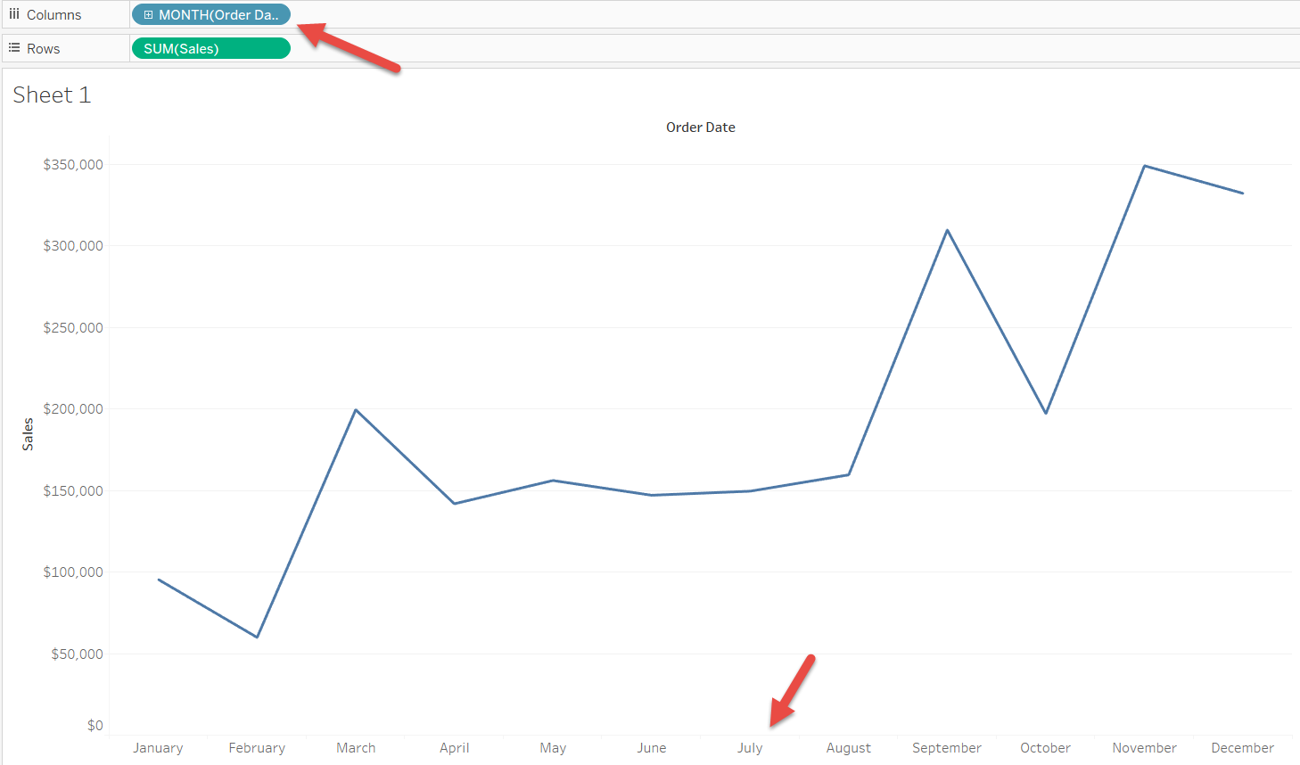
DISCRETE DATE AGGREGATION
Notes:
Illustration of a discrete date visualization (notice that the months on the x axis are actually bins and may be sorted by the value of the measured sales).
Example from the Superstore data set.

Slide 43
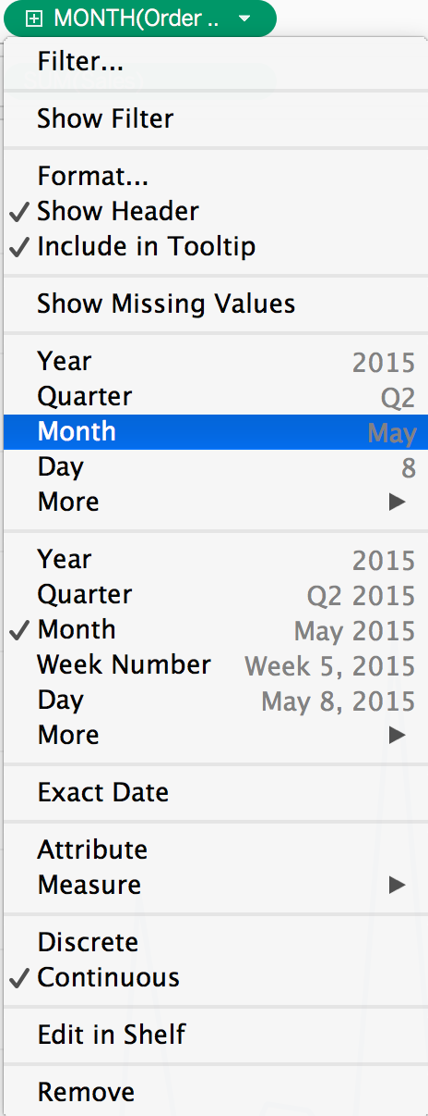
DISCRETE DATE AGGREGATION
If we choose “Month” where the example is listed as May, then it will aggregate across all years.
The resulting table is on the next slide.
Notes:
Example from the Superstore data set.

Slide 44
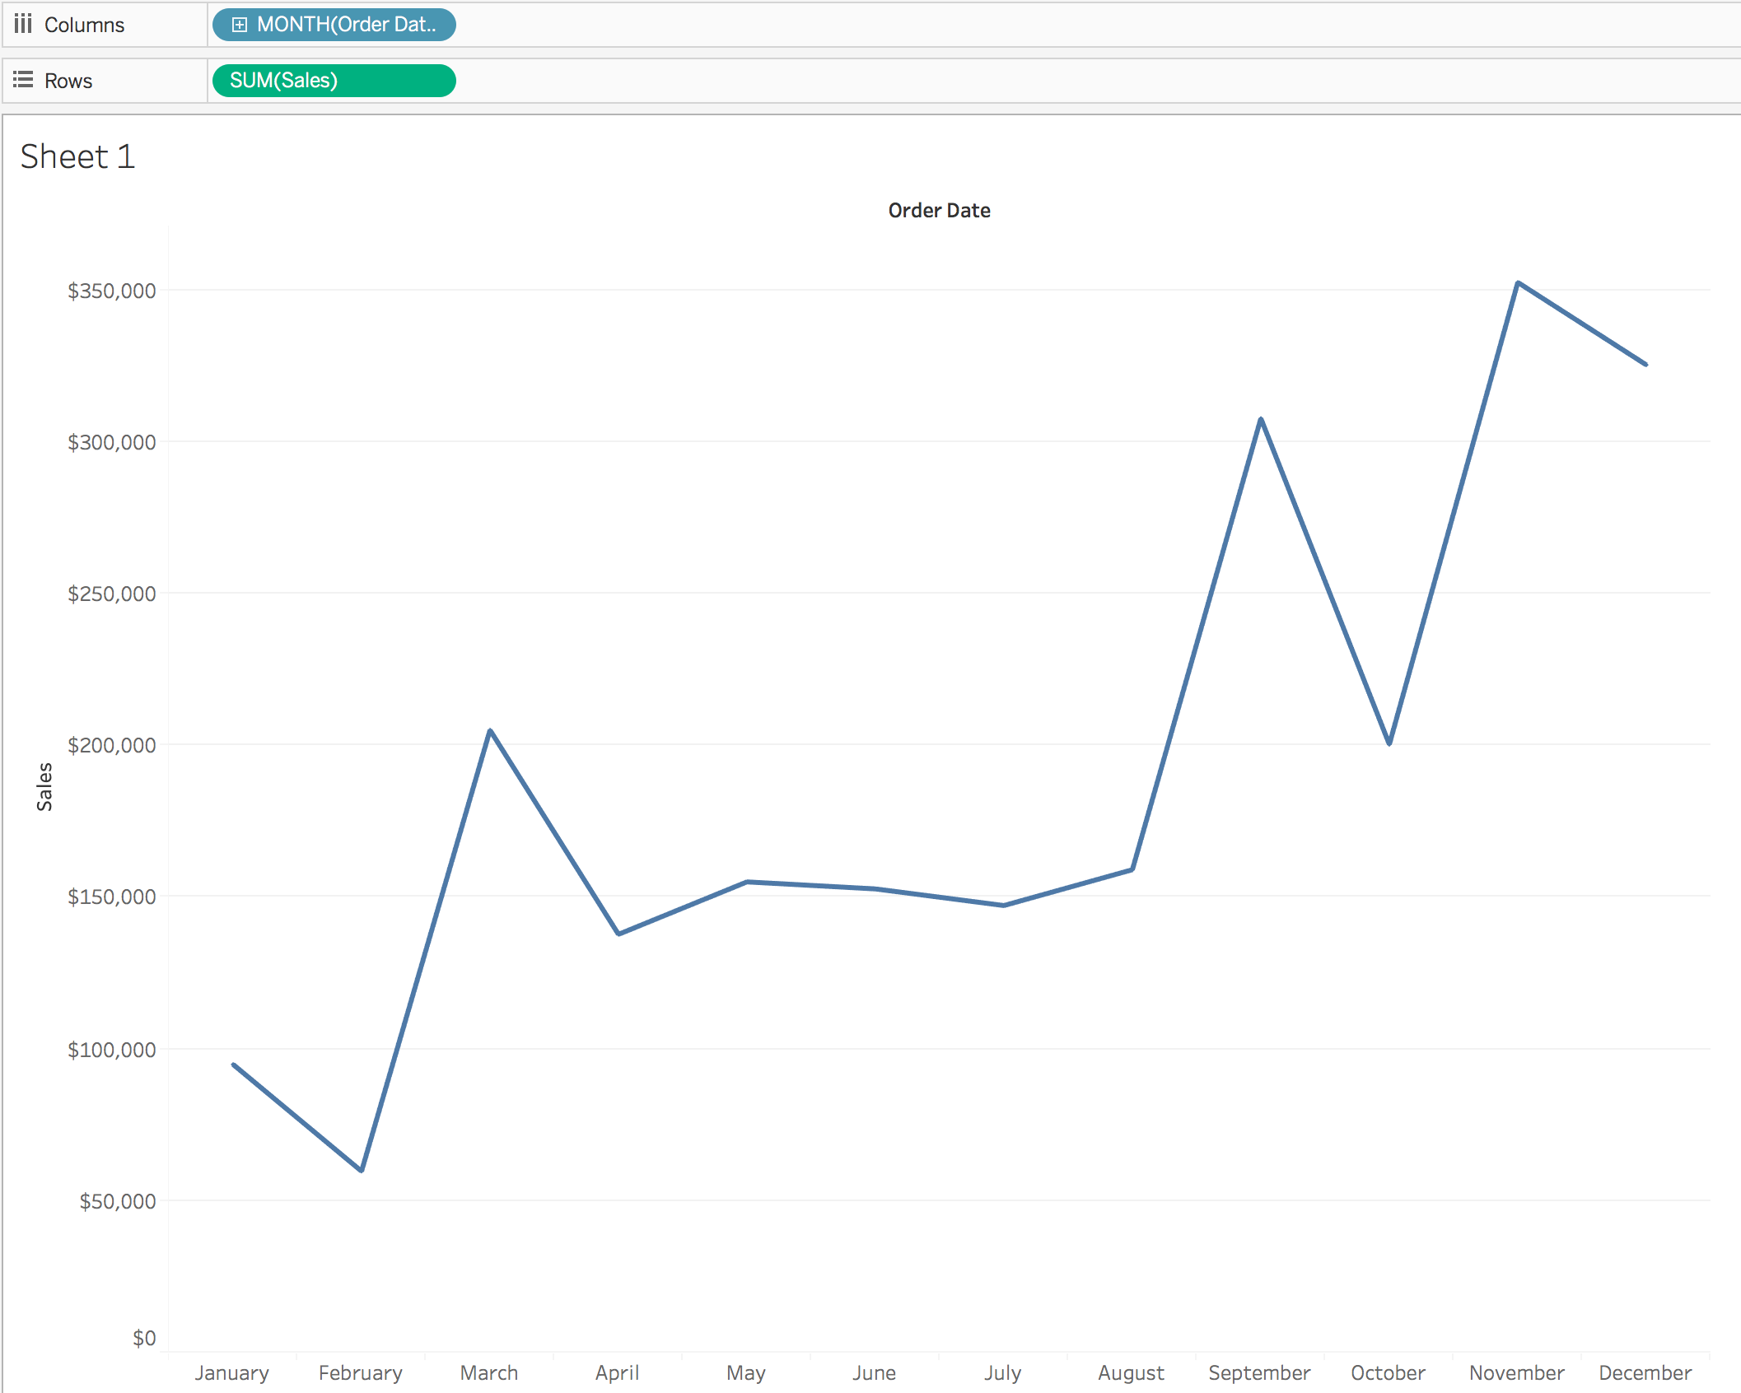
DISCRETE DATE AGGREGATION
This graph shows us the sum of sales by month, regardless of what year the sale occurred in.
The dates are stored in bins and may be sorted.
Notes:
Illustration of a discrete date visualization (notice that the months on the x axis are actually bins and may be sorted by the value of the measured sales).
Example from the Superstore data set.

Slide 45
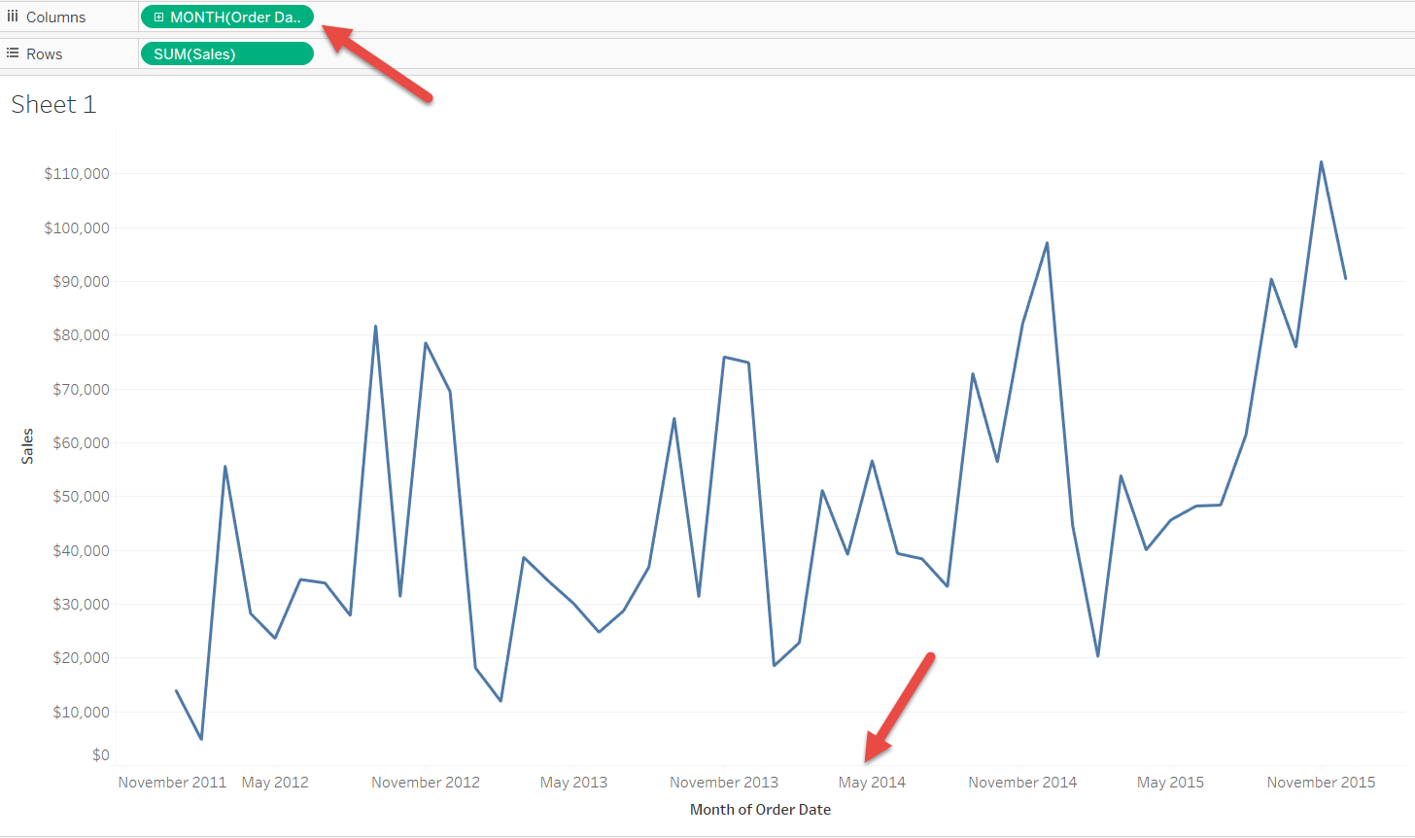
CONTINUOUS DATE AGGREGATION
Notes:
Illustration of a continuous date visualization. This separates each month by year, which may not be sorted.
Example from the Superstore data set.

Slide 46
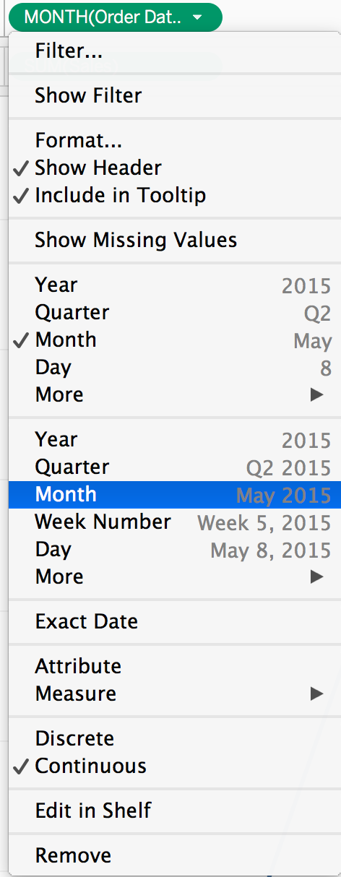
CONTINUOUS DATE AGGREGATION
If we select “Month” where the date is formatted as May 2015, then our dates will be aggregated to year and month.
You can also drill down to week, day, etc.
Notes:
Example from the Superstore data set.

Slide 47
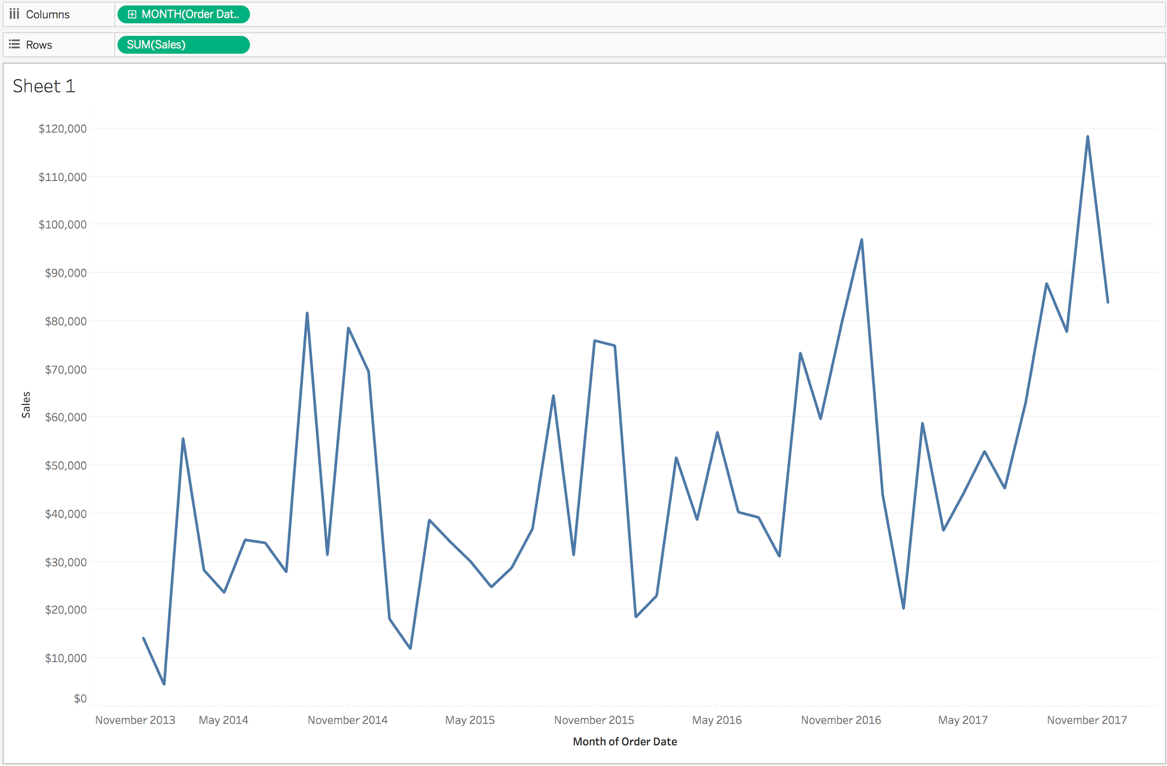
CONTINUOUS DATE AGGREGATION
This graph is slightly different, showing sales by month and year.
It is a standard time series type of chart.
These dates cannot be sorted.
Notes:
Illustration of a continuous date visualization. This separates each month by year, which may not be sorted.
Example from the Superstore data set.

Slide 48
FUNDAMENTALS OF TABLEAU
INDEPENDENT PRACTICE: WORKING WITH DATES

Slide 49
ACTIVITY: WORKING WITH DATES
Recreate the view from independent_dates_01.
Given the question — “What is the hourly bike usage analysis by user type?” — determine whether you will need to use discrete or continuous dates? Why?
Note: Use the “weekday in/out” dataset you previously created.
EXERCISE
Notes:
Instructor Note: We recommend you display the desired outcome to the student using Tableau’s presentation mode (by clicking an icon located at the top-middle of the page, next to the share icon. Students can view the result without seeing which dimensions, measures, filters, etc. were used to create the Viz.
Once students have attempted to create the Viz independently, suggest walking through creating this again as a class. Take questions and discuss issues.

Slide 50
FUNDAMENTALS OF TABLEAU
INTRODUCTION: CALCULATED FIELDS

Slide 51
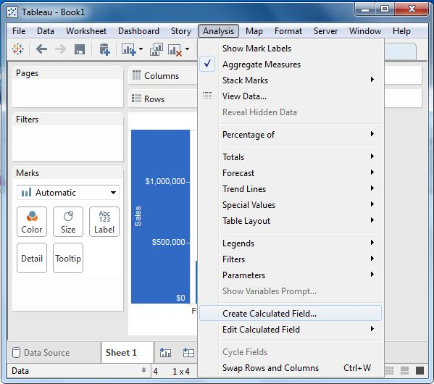
INTRODUCTION TO CALCULATIONS
Calculations can be created in Tableau from the “Analysis” tab.
Notes:
Screen capture of menu location and selection.

Slide 52
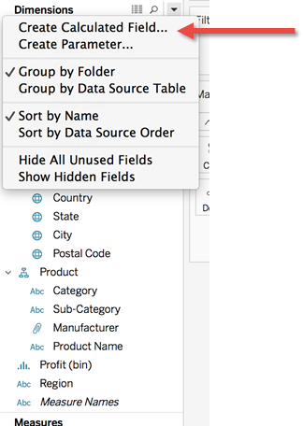
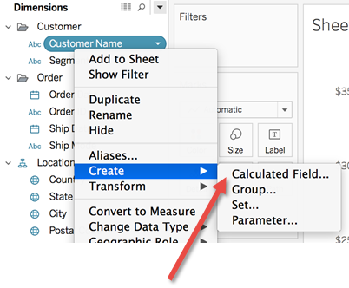
INTRODUCTION TO CALCULATIONS
Calculations can also be created by clicking on the triangle next to dimensions and selecting “Create Calculated Field...”
If you know what specific dimension or measure you’ll use to create a calculated field, you can right click on that pill and select “Create > Calculated Field...”
Notes:
Screen capture of menu location and selection.

Slide 53
INTRODUCTION TO CALCULATIONS
A calculated field is one that you calculate; it gives you a large amount of flexibility on how you want to see your data.
Calculated fields can be used against text to combine multiple fields.
Pro Tip: Calculations function like an IF statement in programming, which is similar to a CASE statement in SQL.

Slide 54
INTRODUCTION TO CALCULATIONS
Calculated fields also give us the ability to perform mathematical operations on different measures.
For example, if you have sales as one measure and population as another, you can determine sales per capita as a new measure.
There are too many field types for us to cover in this class, but if you want to learn more about fields we don’t discuss, you can find more tutorials on the Tableau reference site.

Slide 55
FUNDAMENTALS OF TABLEAU
GUIDED PRACTICE: DASHBOARDS & STORY POINTS

Slide 56
DASHBOARDS AND STORY POINTS
Dashboards allow you to combine multiple visualizations in a single view and add interactions between those visualizations.
Story Points combine multiple dashboards or visualizations into an interactive full-screen presentation.
Notes:
Dashboards are a key feature of Tableau and, unlike other BI visualization products, may be created without any programming.
Simply drag and drop individual visualizations to create a dashboard. Commonly referenced data between visualizations may be further connected using filters (without coding).
Once dashboards have been created, these may be linked, along with individual visualizations, into an overall presentation mode called Story Points. This is unique to Tableau.

Slide 57
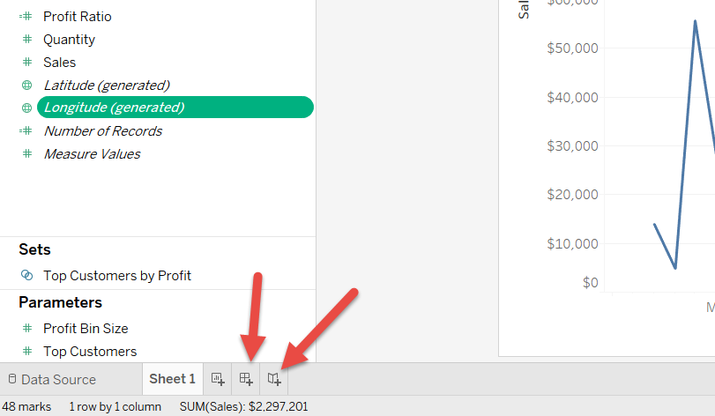
DASHBOARDS AND STORY POINTS
Create dashboards and Story Points using tabs at the bottom of the screen.
Create a new Dashboard.
Create a new Story Points prez.
Notes:
Location of buttons to create a new dashboard or Story Points presentation (which is a collection of dashboards and visualizations).

Slide 58
FUNDAMENTALS OF TABLEAU
INDEPENDENT PRACTICE: DASHBOARDS & STORY POINTS

Slide 59
ACTIVITY: DASHBOARDS AND STORIES
In groups, build your own graphs, dashboards, or stories that show the key differences between subscribers and customers (user type).
Pro Tip: Under Tableau’s worksheet menu, locate and select “Describe Sheet” to see how each of the example stretch activity’s visualizations are constructed.
As a team, present your visualizations and findings to the class.
Notes:
Review the Divvy data slide with data definitions and metadata to clarify the differences between subscribers and customers.
Answer: Subscriber data (and their dependents) include gender and date of birth.
Customer data (short-term 24-hour renters) do not.

Slide 60
FUNDAMENTALS OF TABLEAU
CONCLUSION

Slide 61
REVIEW: FUNDAMENTALS OF TABLEAU
RECAP
In this lesson, we learned how to:
Connect and prepare data to import into Tableau.
Explore the basics of the Tableau interface.
Build graphs, calculated fields, dashboards, and stories.
Work with discrete and continuous dates in Tableau.

Slide 62
FUNDAMENTALS OF TABLEAU
RESOURCES

Slide 63
FUNDAMENTALS OF TABLEAU
RESOURCES
Visual Analysis Best Practices (Tableau): https://www.tableau.com/learn/whitepapers/tableau-visual-guidebook
Which Chart or Graph is Right for You? (Tableau): https://www.tableau.com/sites/default/files/media/which_chart_v6_final_0.pdf
Tableau “Starter Kits” (role-based tutorials): https://www.tableau.com/learn/starter-kits

